Slide 1

Intelligent Video Surveillance Using Deep Learning System Project phase – Ii
Project Guide – Mr. Ashish Bishnoi
Dr. Saurabh Pathak
Submitted By –
Aviral Jain (TCA1959029)
Saksham Jain (TCA1959030)

Slide 2
Problem statement
In current era, where so many security measures are apply for everyone’s safety such as police, department for every affairs. So many cities are installing CCTV for recording every movement in the city and have record for every incident happening in the city. But it has some faults in it, as it cannot alarm the officer or the department at real time while any abnormal activity is occurring or happening.
So the main problem is arrive:
How to detect abnormal activities at real time using CCTV surveillance?

Slide 3
Project description
The goal of this project is to develop a python project that can perform image classification in a specific domain. The script will allow users to record a real-time video through their device and classify it into one of several pre-defined categories based on the video content.
The project will involve collecting and preprocessing a large dataset of images that are relevant to the specific domain, training a machine learning model using the dataset, and integrating the model into the python script using multiple libraries. The output will also include a user interface that displays the real-time video and the predicted class label.
The script will have several potential use cases, such as identifying abnormal human activity in a region. By using machine learning to perform image classification, the script will be able to provide more accurate and efficient results than traditional methods, such as manual labeling or keyword searches.
The success of the project will be measured by the accuracy and efficiency of the image classification model, as well as the usability and functionality of the python script. The final deliverables will include the trained machine learning model, the python code, and a report documenting the design and implementation of the project, as well as its potential use cases and future improvements.

Slide 4
CONTEXT DIAGRAM
USER
Interactive UI
Application

Slide 5
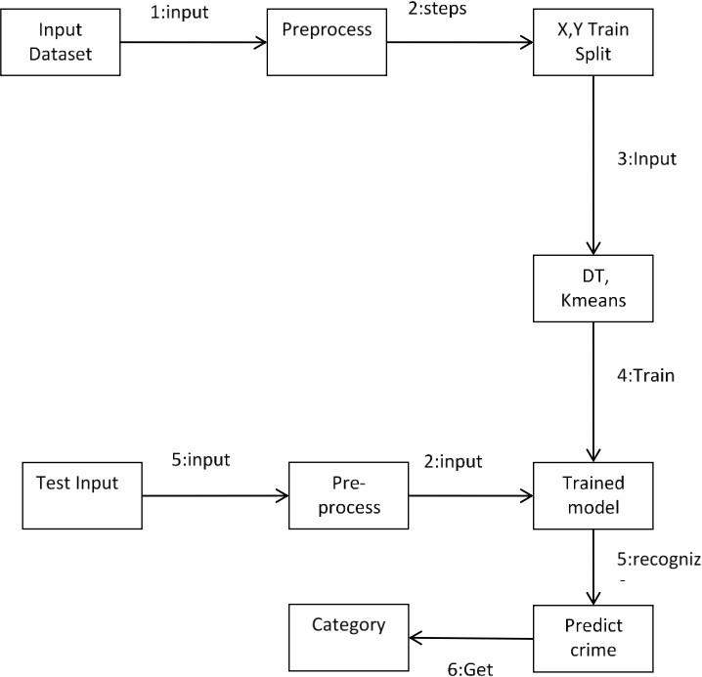
Collaboration diagram
Algorithm
Abnormal activity

Slide 6
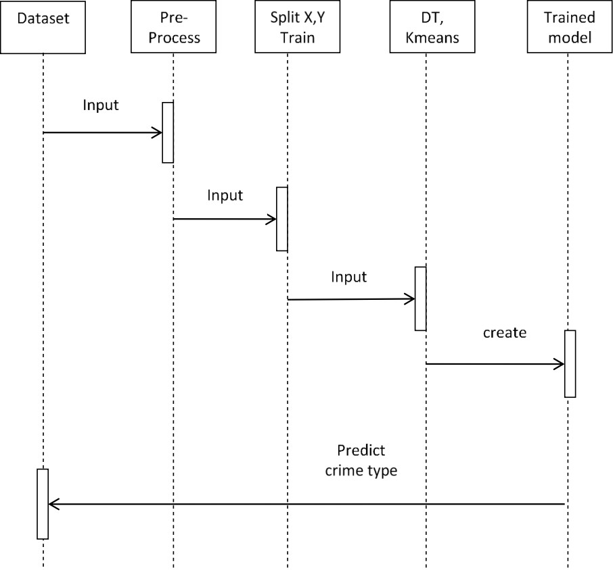
SEQUENCE DIAGRAM
Machine Learning algorithm
Predict abnormal activity type

Slide 7
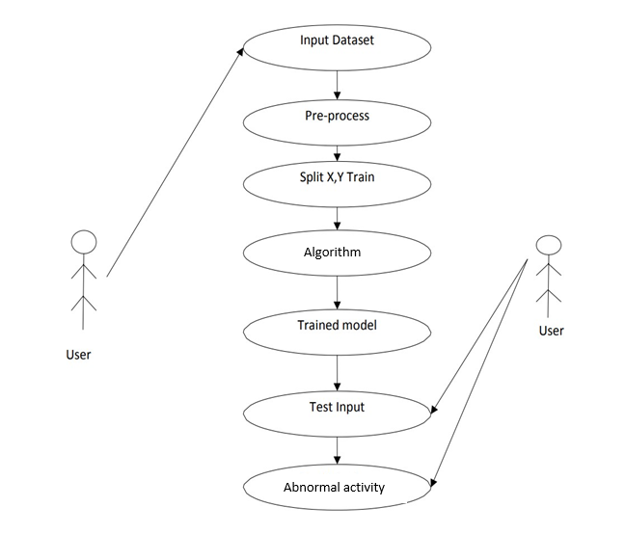
USE CASE DIAGRAM

Slide 8
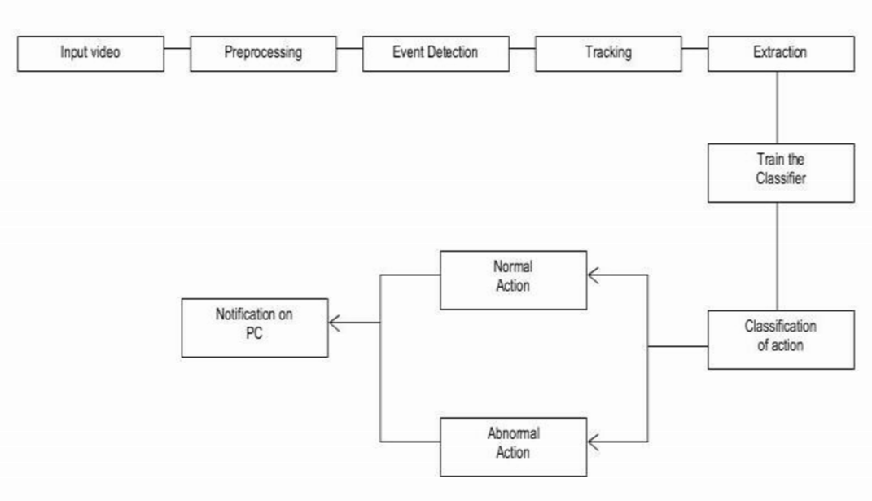
Flow chart
Input video
Preprocessing
Event Detection
Tracking
Extraction
Train the Classifier
Normal Action
Alert on System
Classification of action
Abnormal Action

Slide 9
Project module
Data input Module: In this we are importing the datasets in the form of csv file using pandas library of python. It will read the csv file and return data frame object of the dataset. Pandas is an open source library in Python. It provides ready to use high- performance data structures and data analysis tools. Pandas module runs on top of NumPy and it is popularly used for data science and data analytics.
Data Preprocessing Module: In this we analyze the data and remove the null values and unnecessary data and split the dataset in to train and test data. By preprocessing data, we make it easier to interpret and use. This process eliminates inconsistencies or duplicates in data, which can otherwise negatively affect a model's accuracy. Data preprocessing also ensures that there aren't any incorrect or missing values due to human error or bugs.
Feature Extraction Module: Feature Extraction is done for finding out the most relevant features from the given datasets.
Training Module: This is the next phase of our model development in this we will start the model training on the preprocessed dataset using the K-Means and Decision Tree Algorithms. Model Training is done on training dataset which is approx. 70-80 percent of total data.

Slide 10
TECHNOLOGY USED
Software Platform :
VS Code
Google Colab
Python
Hardware Platform :
For Developer : For Client :
Operating System: Windows, Linux, Mac OS Operating System Windows, Linux, Mac OS, Android 6.0+
RAM 12GB RAM 4GB
INTERNAL STORAGE 12 GB INTERNAL STORAGE 1 TB
CPU 1.6GHz CPU 1.6GHZ

Slide 11
conclusion
The proposed system aims to open a new door in the field of video surveillance and provide the result on the basis to detect abnormal activities. It will help the user to monitor any abnormal activities or suspicious events. It's been very difficult to monitor abnormal activities in various fields like security, crime prevention, traffic monitoring. It will help the user by sending an alert message when an abnormal condition is identified. The number of parameters currently included is an attempt to cover all the basic aspects of video surveillance and other overlooked parameters which deserve recognition. This work is interested in the recognition of abnormal human activities by providing a brief analysis of the recent research tasks in this field of video surveillance. We have implemented the CNN to detect abnormal activities. Finally, through this analysis of the recent research tasks in this field of video surveillance and provide the result on the basis to detect abnormal activities.

Slide 12


Thank you !!

